Slide 1

Problem Statement
"Sports Basics" is a sports blog company that entered space recently. They wanted to get more traffic to their website by releasing a special edition magazine on IPL 2024. This magazine aims to provide interesting insights and facts for fans, analysts and teams based on the last 3 years' data.
The chief editor Tony Sharma oversees this publication, and he believes in data analytics. He reached out to Peter Pandey, a journalist in his team who is a data savvy cricket enthusiast.

Slide 2
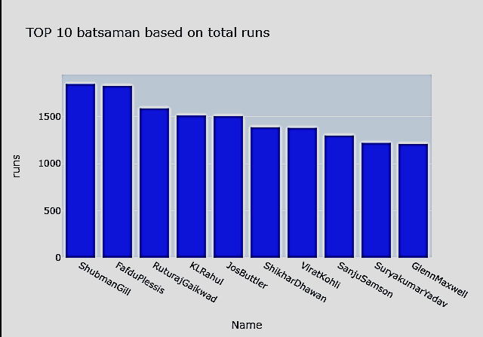
# Primary Insights 1. Top 10 batsmen based on past 3 years total runs scored

Slide 3
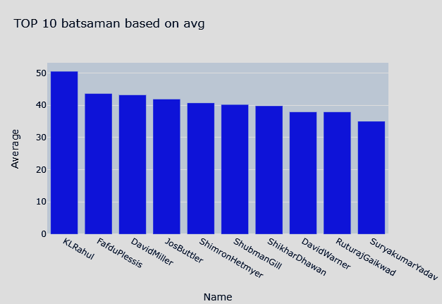
2. Top 10 batsmen based on past 3 years batting average. (min 60 balls faced in each season)

Slide 4
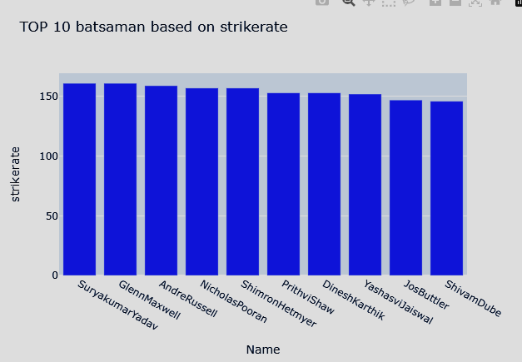
3. Top 10 batsmen based on past 3 years strike rate (min 60 balls faced in each season)

Slide 5
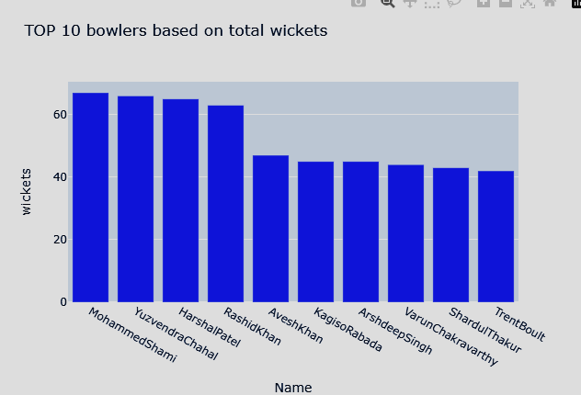
4. Top 10 bowlers based on past 3 years total wickets taken.

Slide 6
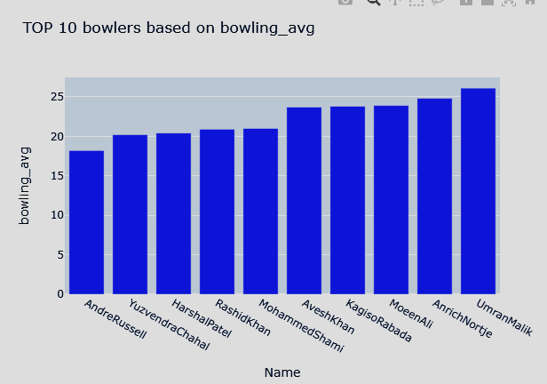
5. Top 10 bowlers based on past 3 years bowling average. (min 60 balls bowled in each season)

Slide 7
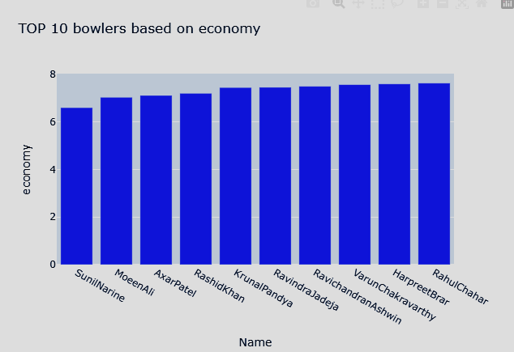
6. Top 10 bowlers based on past 3 years economy rate. (min 60 balls bowled in each season)

Slide 8
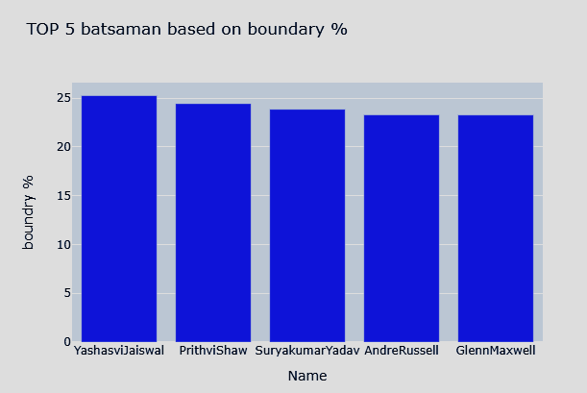
7. Top 5 batsmen based on past 3 years boundary % (fours and sixes).

Slide 9
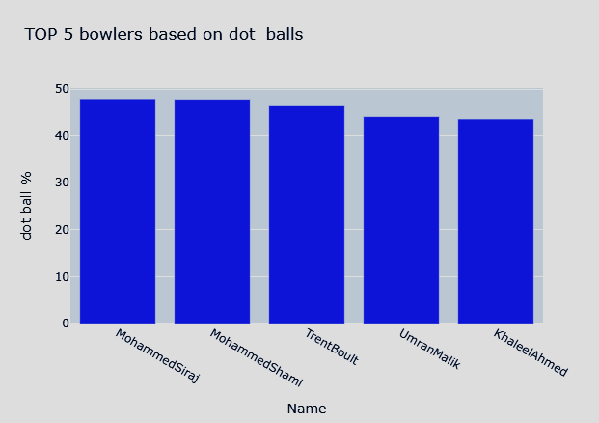
8. Top 5 bowlers based on past 3 years dot ball %.

Slide 10
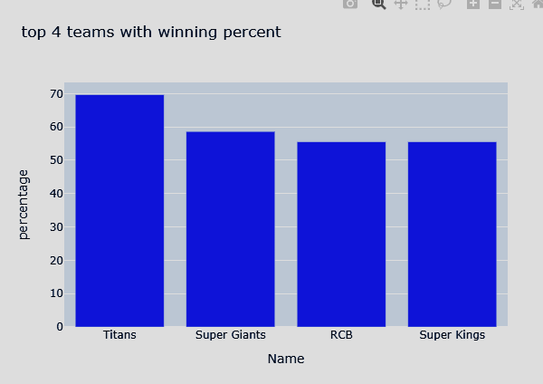
9. Top 4 teams based on past 3 years winning %.

Slide 11
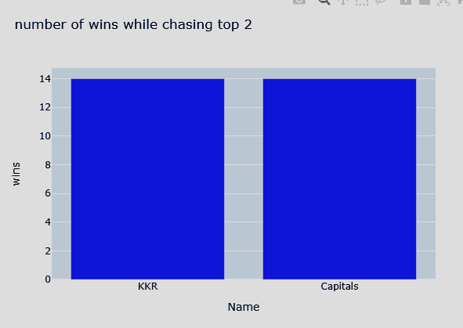
Top 2 teams with the highest number of wins achieved by chasing targets over the past 3 years.

Slide 12
# Secondary Insights 1. Orange and purple cap player
Orange cap
Yashasvi jaiswal
Jos Buttler
Shubman Gill
Purple cap
Yuzvendra Chahal
trent boult

Slide 13
2. Top 4 qualifying teams
1. RCB
2. CSK
3. Rajasthan Royals
4. Mumbai Indians

Slide 14
Winner and runner-up
winner: RCB
Runner-up : Mumbai Indians

Slide 15
Your Picks Best 11
1. Shubman Gill
2. Yashasvi Jaiswal
3. Surya kumar Yadav/sanju samsan
4. Glenn Maxwell
5. rinku singh/David Miller
6. Andre Russell
7. Ravindra Jadeja
8. Mohammed Shami
9. Trent Boult
10. Yuzvendra Chahal
11. Mohammed Siraj

Slide 16
Top 3 all-rounders
1. Ravindra Jadeja
2. Hardik Pandya
3. Andre Russell

